Slide 1

Comprehensive Antibody
Analysis Service

Slide 2
Service List
1. Surface Plasmon Resonance (SPR)
2. Biolayer Interferometry (BLI)
3. Hybridoma Sequencing
4. High Performance Liquid Chromatography (HPLC)
5. Capillary Electrophoresis (CE)
6. Automated Capillary Electrophoresis (LabChip)
7. Endotoxin Test

Slide 3

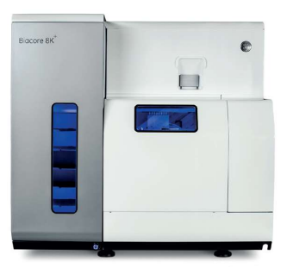
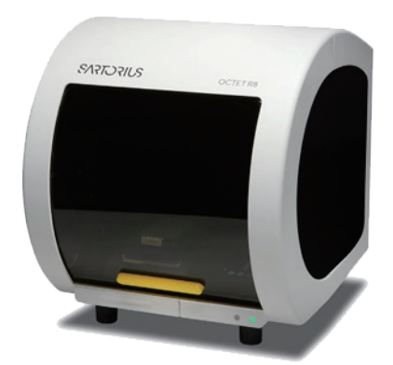
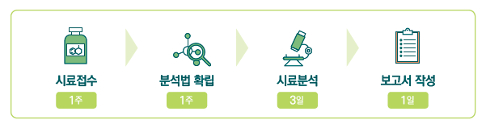
Surface Plasmon Resonance (SPR) &
Biolayer Interferometry (BLI)
We provide precise antibody affinity analysis, essential for lead molecule screening in drug development.
Equipment
BiacoreTM 8K System
Label-free
Kinetics, affinity, epitope binding
High sensitivity
High sample throughput
Suitable for small molecules and peptides
Octet® R8 System
Label-free, fluidics-free
Real-time affinity monitoring with 8 simultaneous biosensors
High sensitivity
Suitable for cell culture supernatant and serum analysis
BiacoreTM 8K
Octet® R8
Key Features
Procedure
Designing customized analytical methods
Providing expert consulting on analytical methods
Managing projects efficiently
Sample Receipt
Method Establishment
Sample Analysis
Report
1 week
1 week
3 days
1 day
Hybridoma Sequencing
We provide rapid hybridoma cell sequencing, a crucial step in antibody-based therapy development.
Key Features
Rapid sequence
obtaining
Rapid hybridoma monoclonal antibody sequencing using our diverse range of primers
Uniform Production
Cell
Maintenance
Backbone
Fc
switching
Switch to various isotype Fc including
human, mouse
Uniform production of desired antibody from in vivo studies
Reduce cell maintenance burden
Switch to fully human antibodies
Rapid antibody production
Rapid antibody production using our proprietary expression system
Procedure
1) RNA prep (Kit)
2) cDNA synthesis (Kit)
3) HC, LC, PCR (polymerase, primer)
4) T-vector ligation (DH5a)
5) Transformation (DH5a)
1) Colony PCR (polymerase, M13F/R)
2) Mini prep
3) Sequencing (8 each)
4) Sequencing verification (verify 2-3 identical sequences from alignment results)
Seeding
Max 2 days
1 day
Max 2 days

Slide 4
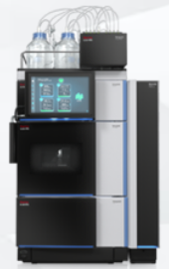
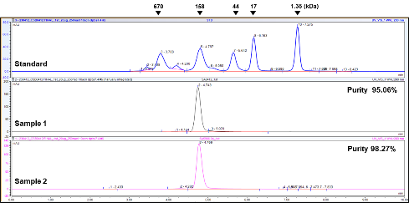
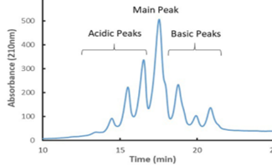
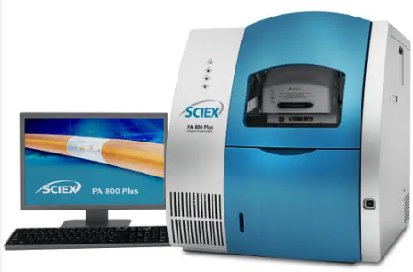
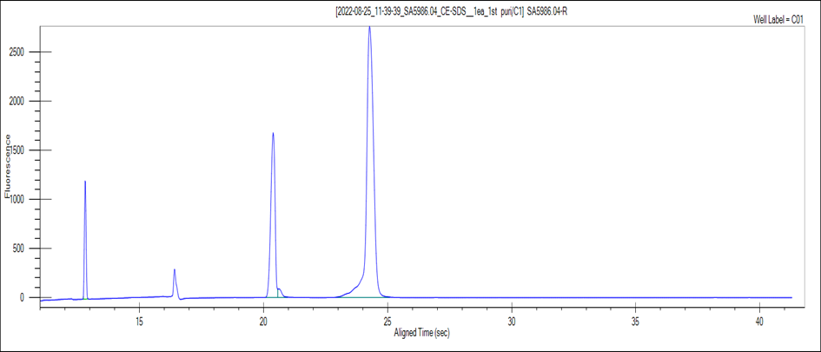
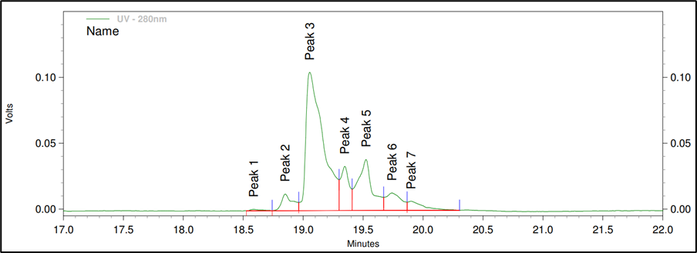
High Performance Liquid Chromatography (HPLC)
We provide high-quality sample separation and precise identification through both qualitative and quantitative analyses.
Sample Analysis Result
SE-HPLC analysis | CEX-HPLC analysis
Quantification, purity | Charge variant analysis, purity
Qualitative/quantitative chromatogram analysis according to analyte peak retention time and area
Qualitative: analyte peak retention time, Quantitative: analyte peak height (peak area, integration)
Vanquish Core HPLC
Refer to information on Thermo Fisher’s official website
Capillary Electrophoresis (CE)
We provide attribute-based product purity, charge heterogeneity and glycan analysis for protein-based therapeutics development and quality control.
PA 800 Plus
MAbs | Plasmid and nucleic acid therapeutics
Peptide / proteins | Other biotherapeutics
PA 800 Plus
Key Features
Protein purity analysis: Quantitative protein purity analysis via SDS-Gel electropheresis
Glycan analysis: High-speed, high-resolution glycan analysis with automated identification
Charge heterogeneity analysis: High-speed capillary isoelectric focusing (cIEF) and capillary zone electrophoresis (CZE)
Peptide/protein attributes analysis: Characterization of peptide- and protein-based biotherapies
Sample Analysis Result
CE-SDS | Molecular weight sizing, purity
clEF | The separation of protein based on their isoelectric point (pI)

Slide 5
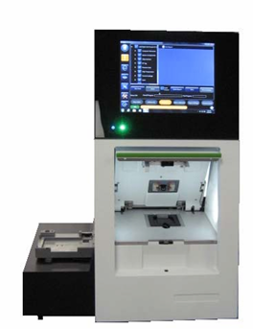
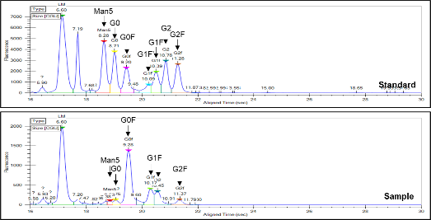
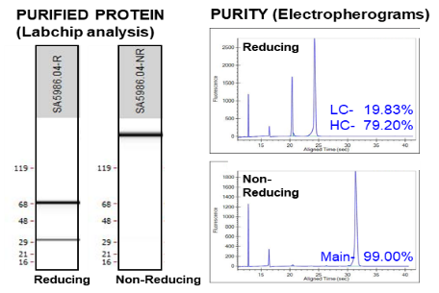
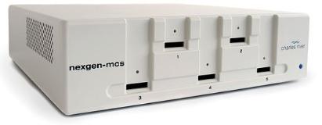
LabChip
(Automated Capillary Electrophoresis)
We utilize microfluidic chips to offer superior accuracy and resolution for protein size and glycan distribution, providing real-time results. Data can be displayed on-screen and easily saved for further analysis, offering significant advantages over traditional gel electrophoresis.
LABCHIP® GX II TOUCH HT
Assays | DNA RNA Protein
Application | Fragment DNA Sheared DNA Genomic DNA Total RNA SDS PAGE Glycan Charged Variant
Throughput | High
Plate Compatibility | 96 and 384
Samples per Run | Up to 384
LABCHIP® GX II TOUCH HT
Sample Analysis Result
N-glycan profile analysis | Size variant analysis
Protein-conjugated glycan type, quantity | Molecular weight sizing, Purity
Refer to information on Perkin Elmer’s official website
Endotoxin Test
We perform endotoxin quantification using the Limulus Amoebocyte Lysate (LAL) test, ensuring compliance with drug product safety standards to prevent fever and septic shock.
Concentration detection range : 0.5-0.005 EU/mL (PTS20005F cartridges)
nexgen-MCS TM
Refer to information on Charles River’s official website

